Slide 1

ADAPTIVE CRUISE CONTROL
GURU GHASIDAS VISHWAVIDYALAYA
MINI PROJECT
Electronics and Communication Engineering (4th semester)

Slide 2
SUBMITTED BY…
UNDER THE GUIDANCE OF
ADITYA RAJ
1
22030102
Dr. RAJIV DEY SIR
DIVYANSH PANDEY
2
22030113
3
PRITAM SAHA
22030145
SHASHANKA MANDAL
4
22030159
SUMIT KUMAR
5
22030161

Slide 3
Contents
INTRODUCTION
COMPONENTS AND IT’S EXPLANATION
CIRCUITS
CODE USED
OPERATION
CONCLUSION
FUTURE SCOPE

Slide 4
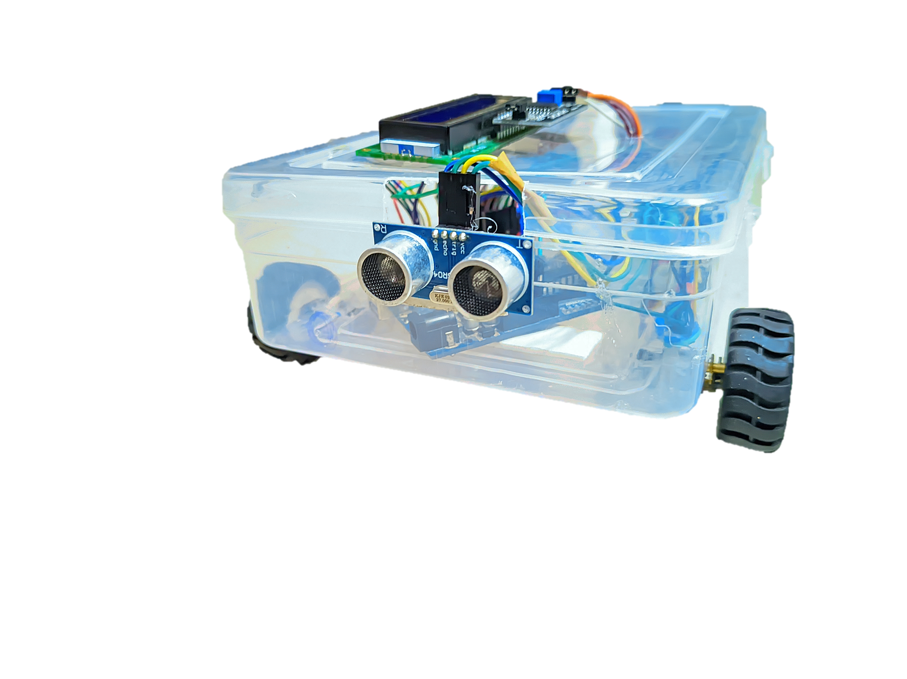
INTRODUCTION
This project focuses on developing an Adaptive Cruise Control (ACC) system using an Arduino microcontroller.
The ACC system is designed to automatically adjust the speed of a car to maintain a safe distance from the vehicle ahead.
The primary components used in this project include an ultrasonic sensor, an LCD display, an H-bridge, a PWM DC motor, and an L298N motor driver.
The system reduces the car's speed linearly as the distance to an obstacle decreases and stops the car when the distance is less than or equal to 10 cm.

Slide 5
COMPONENTS
1
Arduino
2
Ultrasonic Sensor
3
LCD Display
4
H-Bridge
5
PWM DC Motor
6
L298N Motor Driver

Slide 6
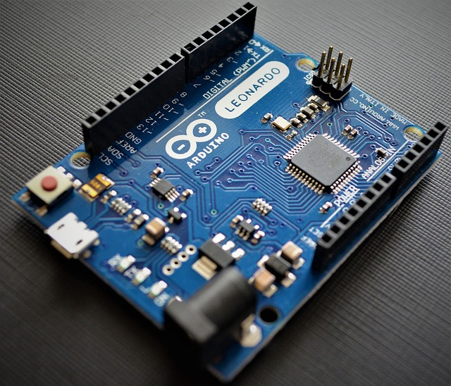
EXPLANATION
Arduino
Function: Acts as the central processing unit for the system.
Details: The Arduino microcontroller reads sensor data, processes it, and sends control signals to the motor driver. It handles all the logic required for distance measurement and speed control.

Slide 7
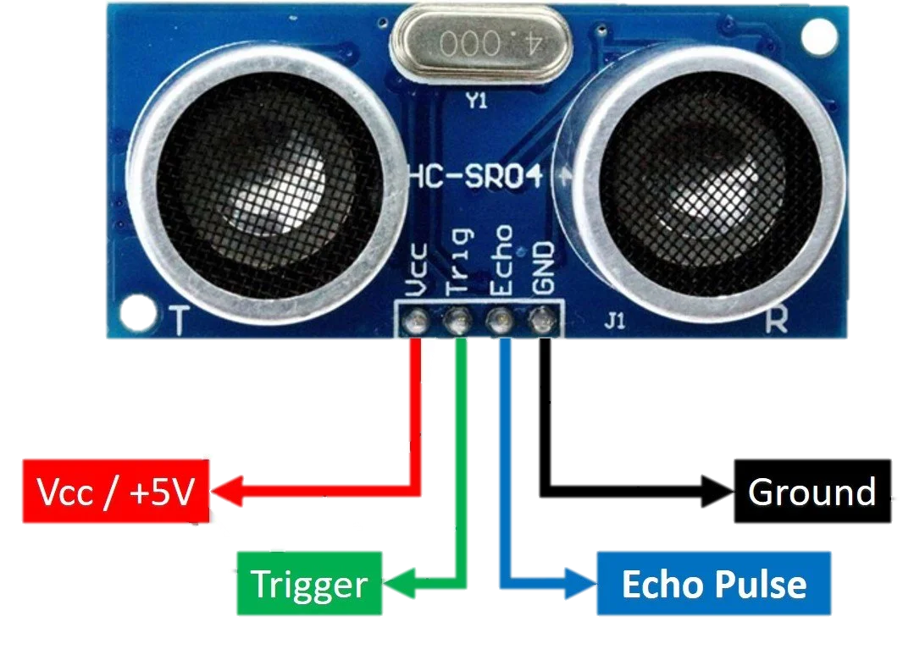
EXPLANATION
Ultrasonic
Sensor
Function: Measures the distance to obstacles in front of the car.
Details: It uses ultrasonic waves to detect objects. The sensor emits an ultrasonic pulse and measures the time taken for the echo to return. This time is then converted into a distance measurement.

Slide 8
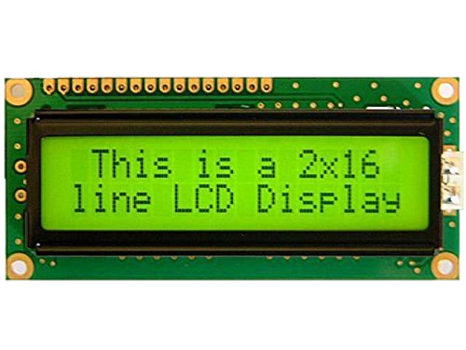
EXPLANATION
LCD Display
Function: Displays the distance detected by the ultrasonic sensor.
Details: A 16x2 character display that communicates with the Arduino via the I2C protocol. It provides a real-time visual indication of the distance to obstacles.

Slide 9
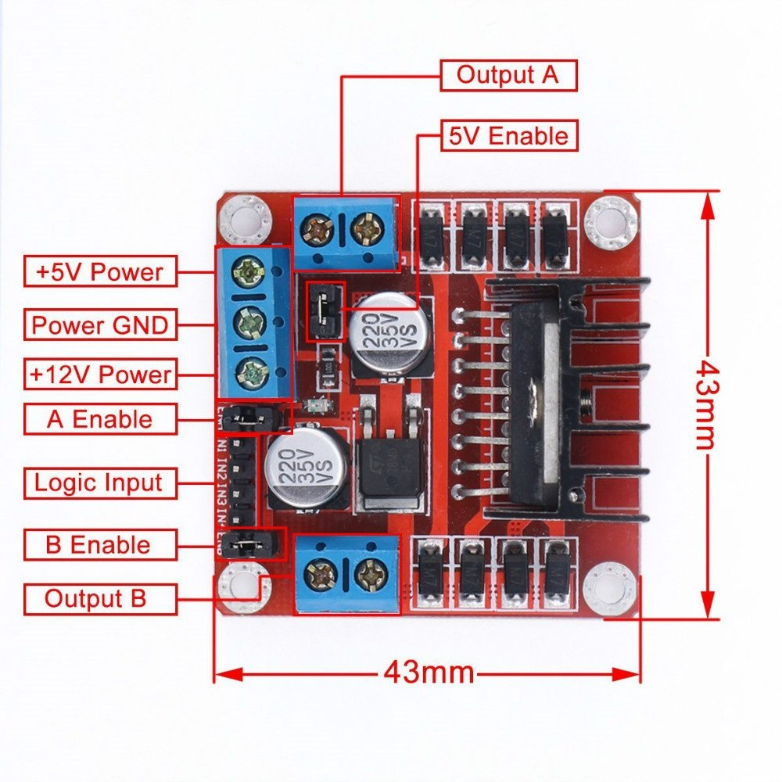
EXPLANATION
H-Bridge
Function: Controls the direction and speed of the DC motor.
Details: The L298 is a dual H-Bridge motor driver that can control the forward and reverse rotation of a DC motor. It receives control signals from the Arduino and drives the motor accordingly.

Slide 10
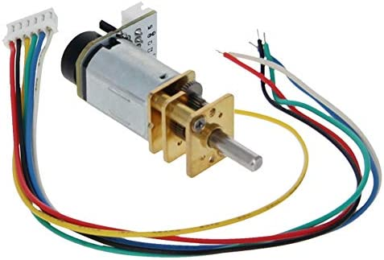
EXPLANATION
PWM DC MOTOR
Function: Drives the car.
Details: A DC motor whose speed is controlled by Pulse Width Modulation (PWM). The Arduino generates PWM signals to adjust the motor speed, allowing for smooth acceleration and deceleration.

Slide 11
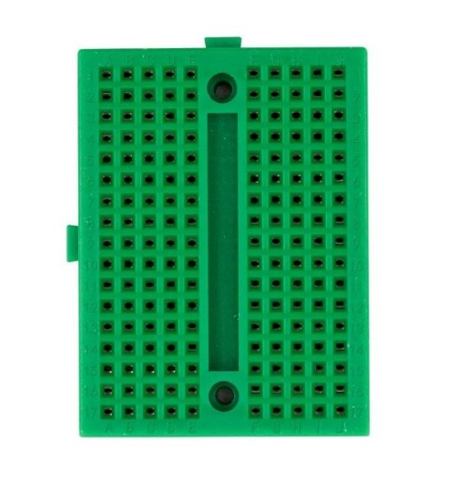
EXPLANATION
BREADBOARD
Function: Facilitates the prototyping of electronic circuits without soldering.
Details: The breadboard allows assembly and modification of circuits, supports testing of components, facilitates integration of modules, and simplifies troubleshooting during development.

Slide 12
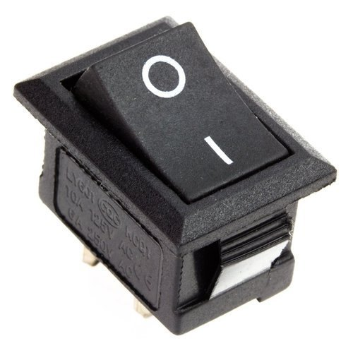
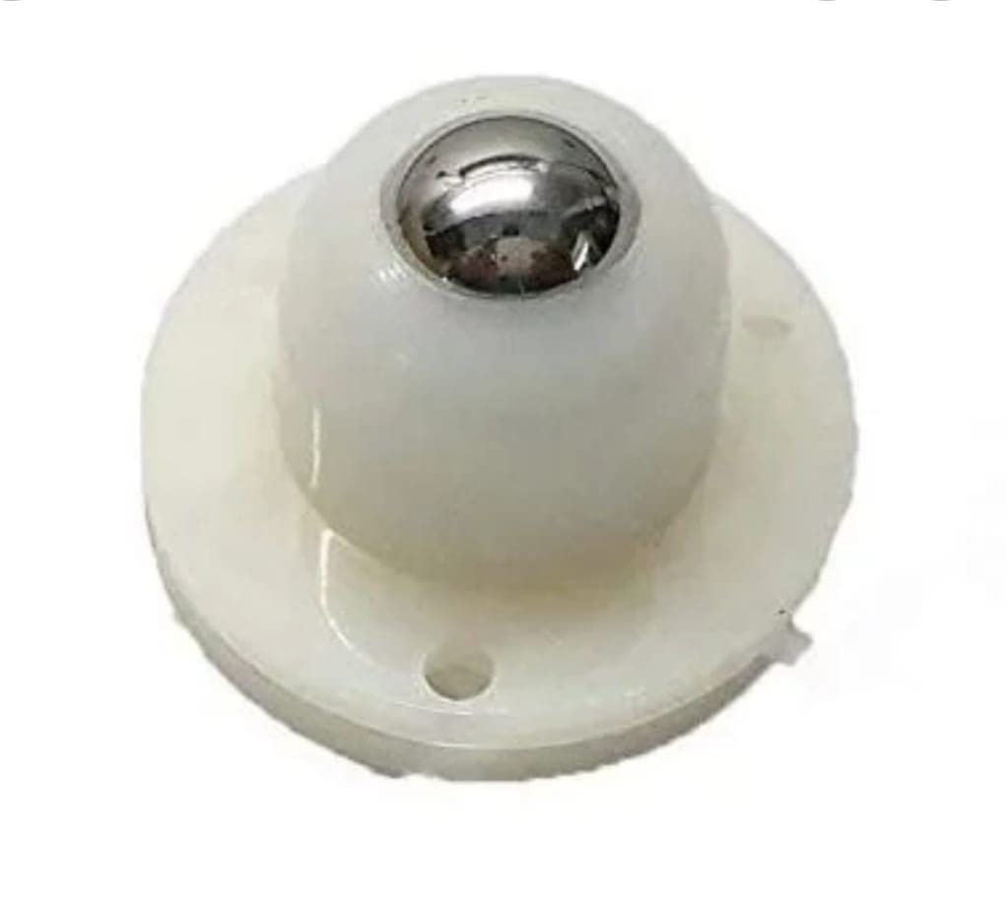
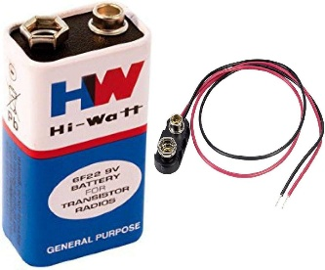
SOME OTHER COMPONENTS
7
8
9
SWITCH
HW-BATTERY
CASTER WHEEL

Slide 13
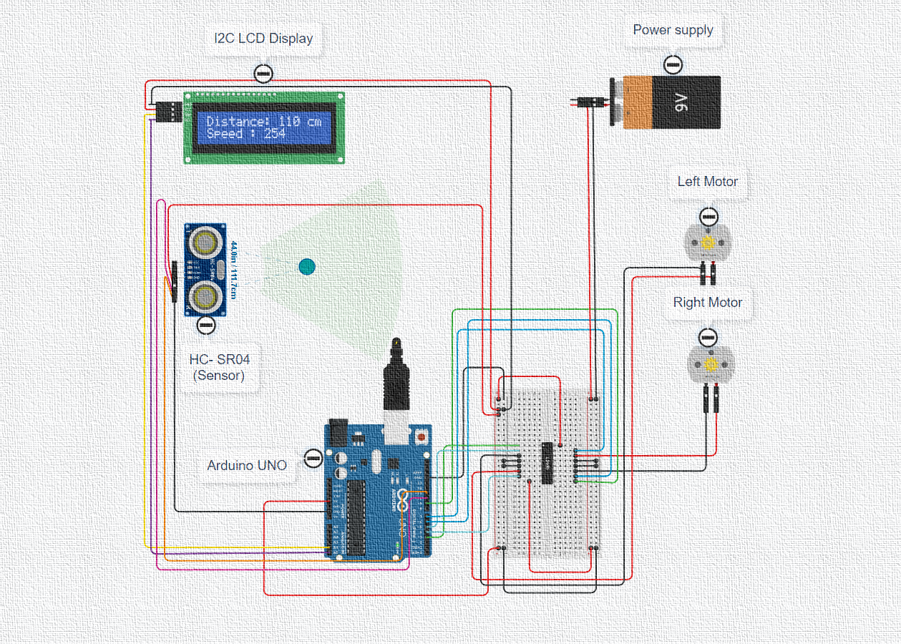
CIRCUIT DIAGRAM
When the motor is “ON”

Slide 14
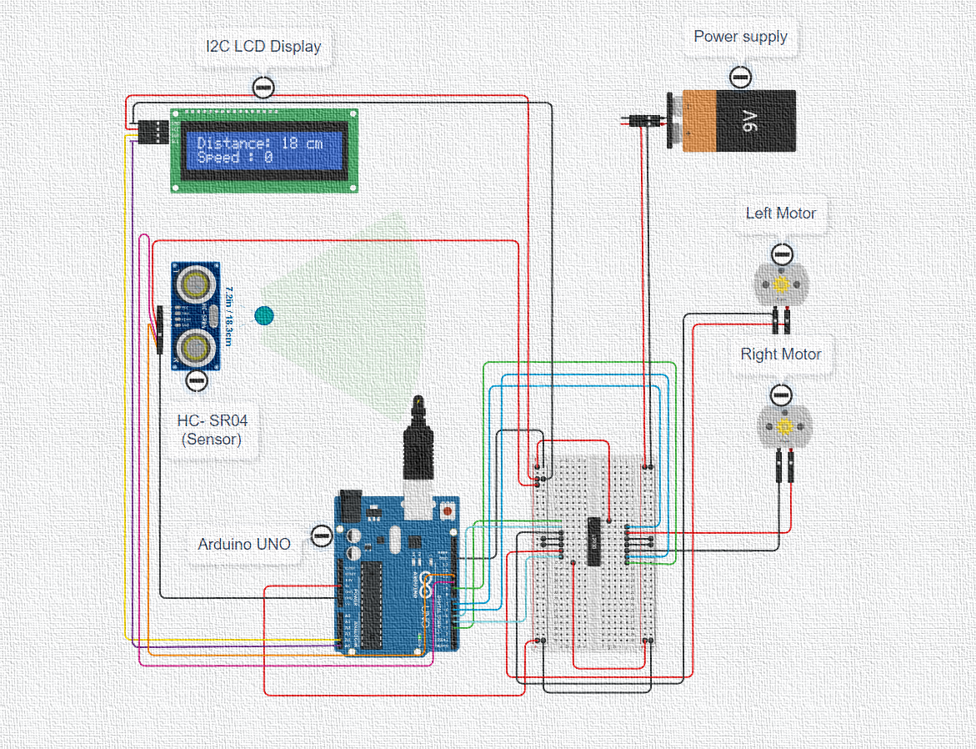
CIRCUIT DIAGRAM
When the motor is “OFF”

Slide 15
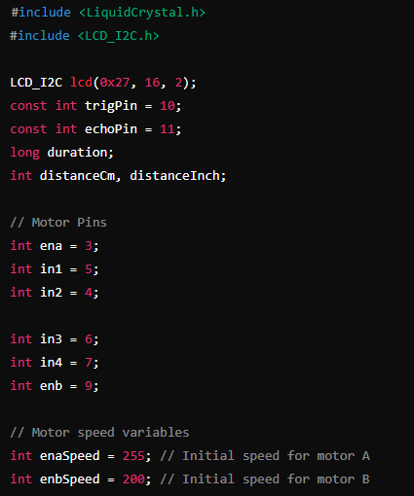
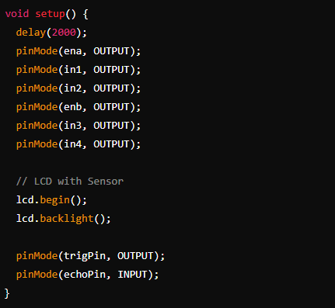

CODE USED

Slide 16
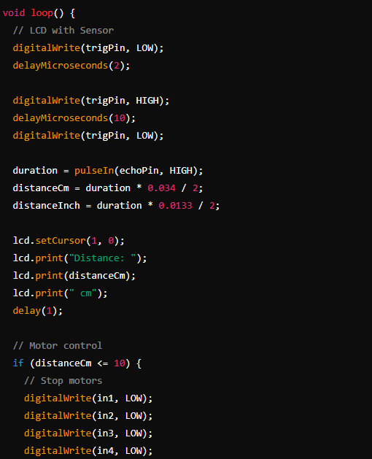
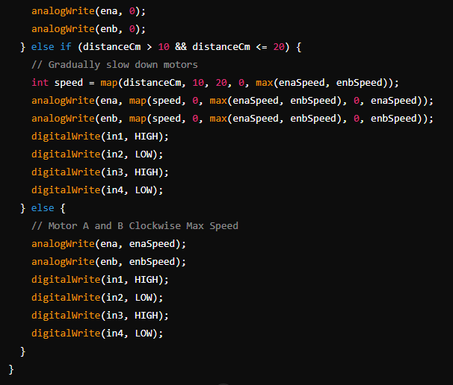
CODE USED

Slide 17
OPERATION
INITIALIZATION
When the system is powered on, the Arduino initializes the LCD and sets the pin modes for the ultrasonic sensor and motor control.
DISTANCE MEASUREMENT
The ultrasonic sensor continuously measures the distance to any obstacle in front of the car.
DISPLAY
The measured distance is displayed on the LCD.
SPEED CONTROL
Distance > 20 cm: Car moves at full speed.
10 cm < Distance ≤ 20 cm: Car's speed decreases linearly.
Distance ≤ 10 cm: Car stops.

Slide 18
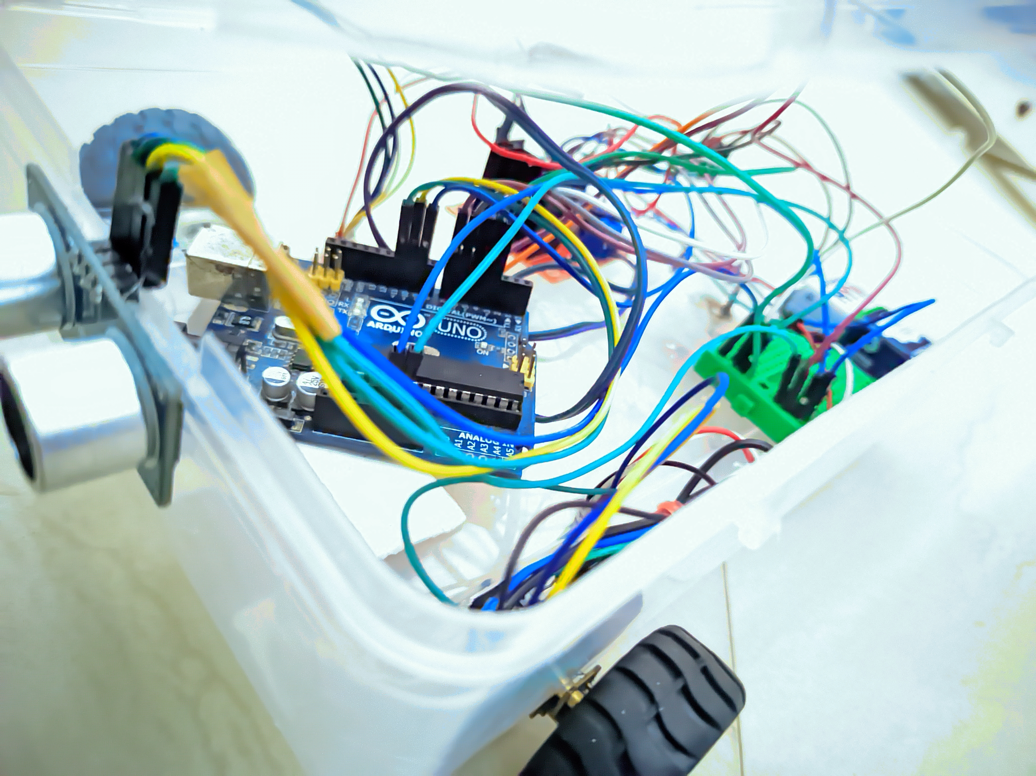
CONCLUSION
This mini project successfully demonstrates an Adaptive Cruise Control system using basic components such as an Arduino, an ultrasonic sensor, an LCD display, an H-bridge, and a PWM DC motor.
The system efficiently manages the car's speed based on the distance to obstacles, ensuring safe operation.
This project lays a foundation for more advanced ACC systems and provides valuable insights into integrating sensors and motor control with Arduino.

Slide 19
FUTURE SCOPE
Enhanced Sensor Integration
Connectivity
Advanced Sensors: Use LIDAR, radar, and infrared.
Multi-Sensor Fusion: Combine multiple sensor data.
V2X Communication: Connect with vehicles and infrastructure.
Remote Monitoring: Bluetooth, Wi-Fi, or cellular for remote control.
Extended Features
Autonomous Driving
Lane-Keeping: Vision-based lane detection.
Adaptive Speed Control: Adjust speed for
traffic and curves.
Collision Avoidance: Evasive maneuvers.
Higher Autonomy: Drive in varied environments.
AI/ML: Improve decision-making and control.
Robotic Applications
Robotic Applications
Autonomous Robots: For logistics,
healthcare, agriculture.
Swarm Robotics: Multi-robot collaboration.
Educational Kits: Teach electronics and robotics.
Research Projects: Autonomous systems
and transportation.

Slide 20
THANK YOU
Aditya Raj (Roll No- 22030102)
Divyansh Pandey (Roll No- 22030113)
Pritam Saha (Roll No- 22030145)
Shashanka Mandal (Roll No- 22030159)
Sumit Kumar (Roll No- 22030161)
UNDER THE GUIDANCE OF:-
Dr. RAJIV DEY SIR

